Slide 1
ENSE 471, Milestone 2
Yumi
Zain, Jinkai, Clark
March 13, 2019
Notes:
Clark

Slide 2
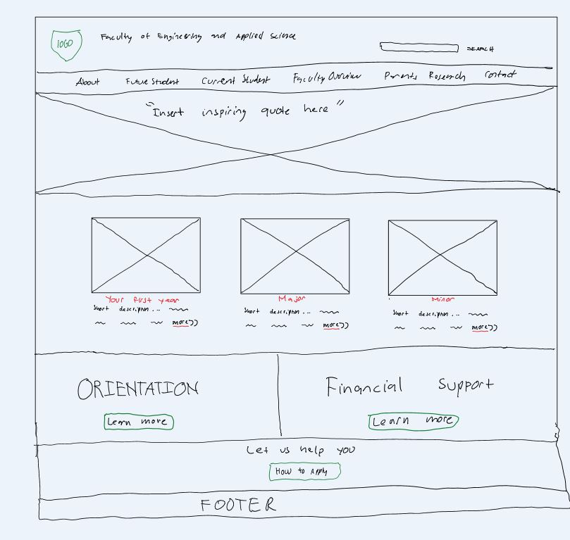
Future Students
This page offers important informations for future students
Notes:
Clark

Slide 3
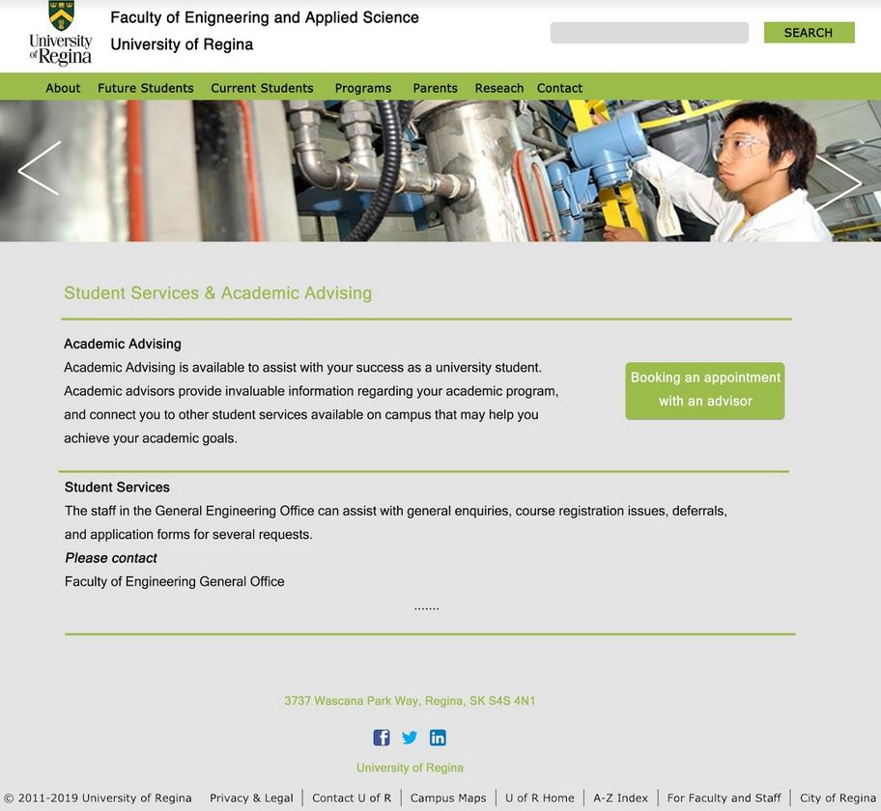
Current Students
In this page user will see academic services information. Also, there’s an option where user can book an appointment.
Notes:
Jinkai

Slide 4
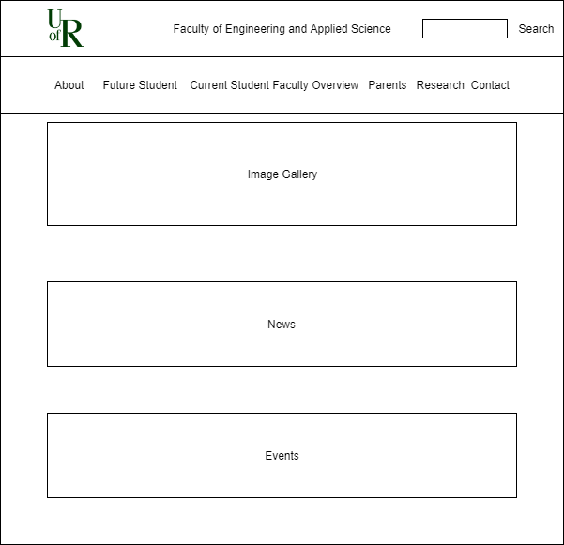
Parents
This page covers the ideation for the parents page.
Recent news and events will be displayed on this page.
Notes:
Zain

Slide 5
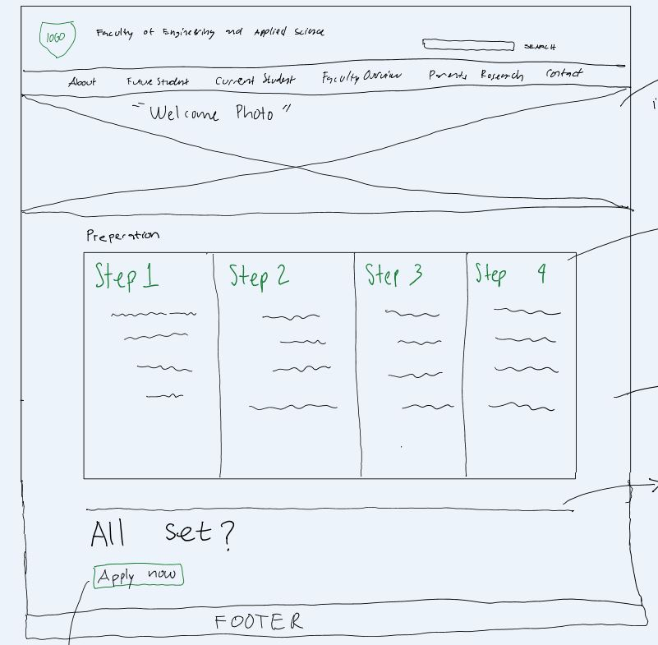
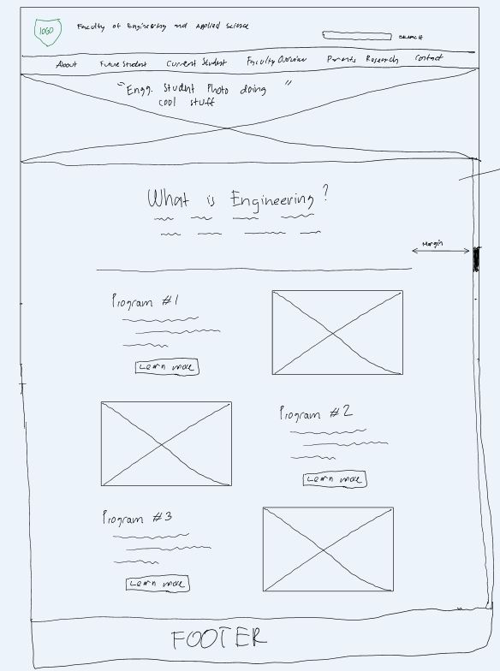
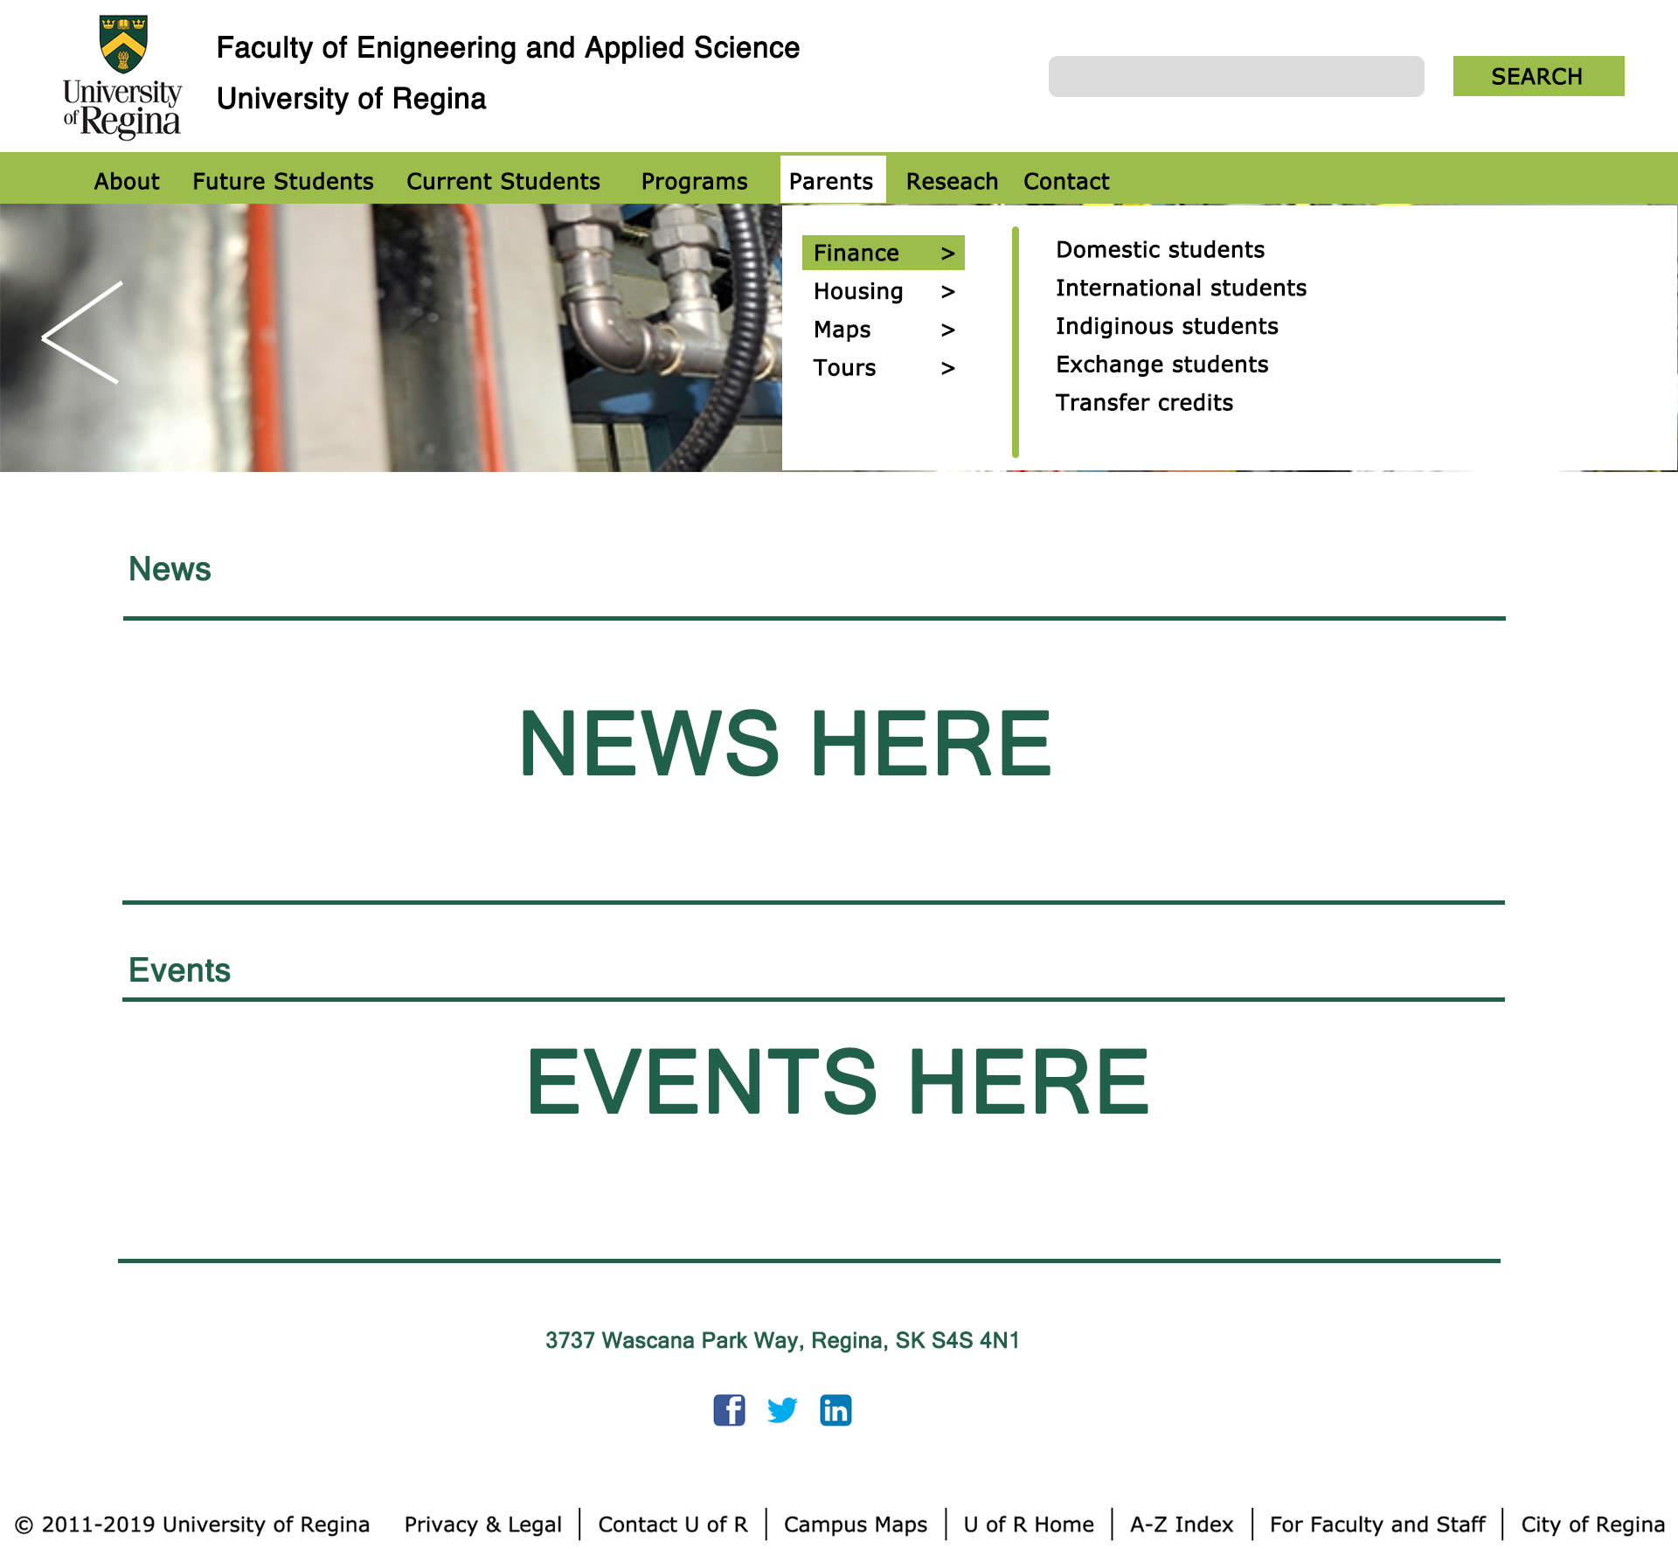
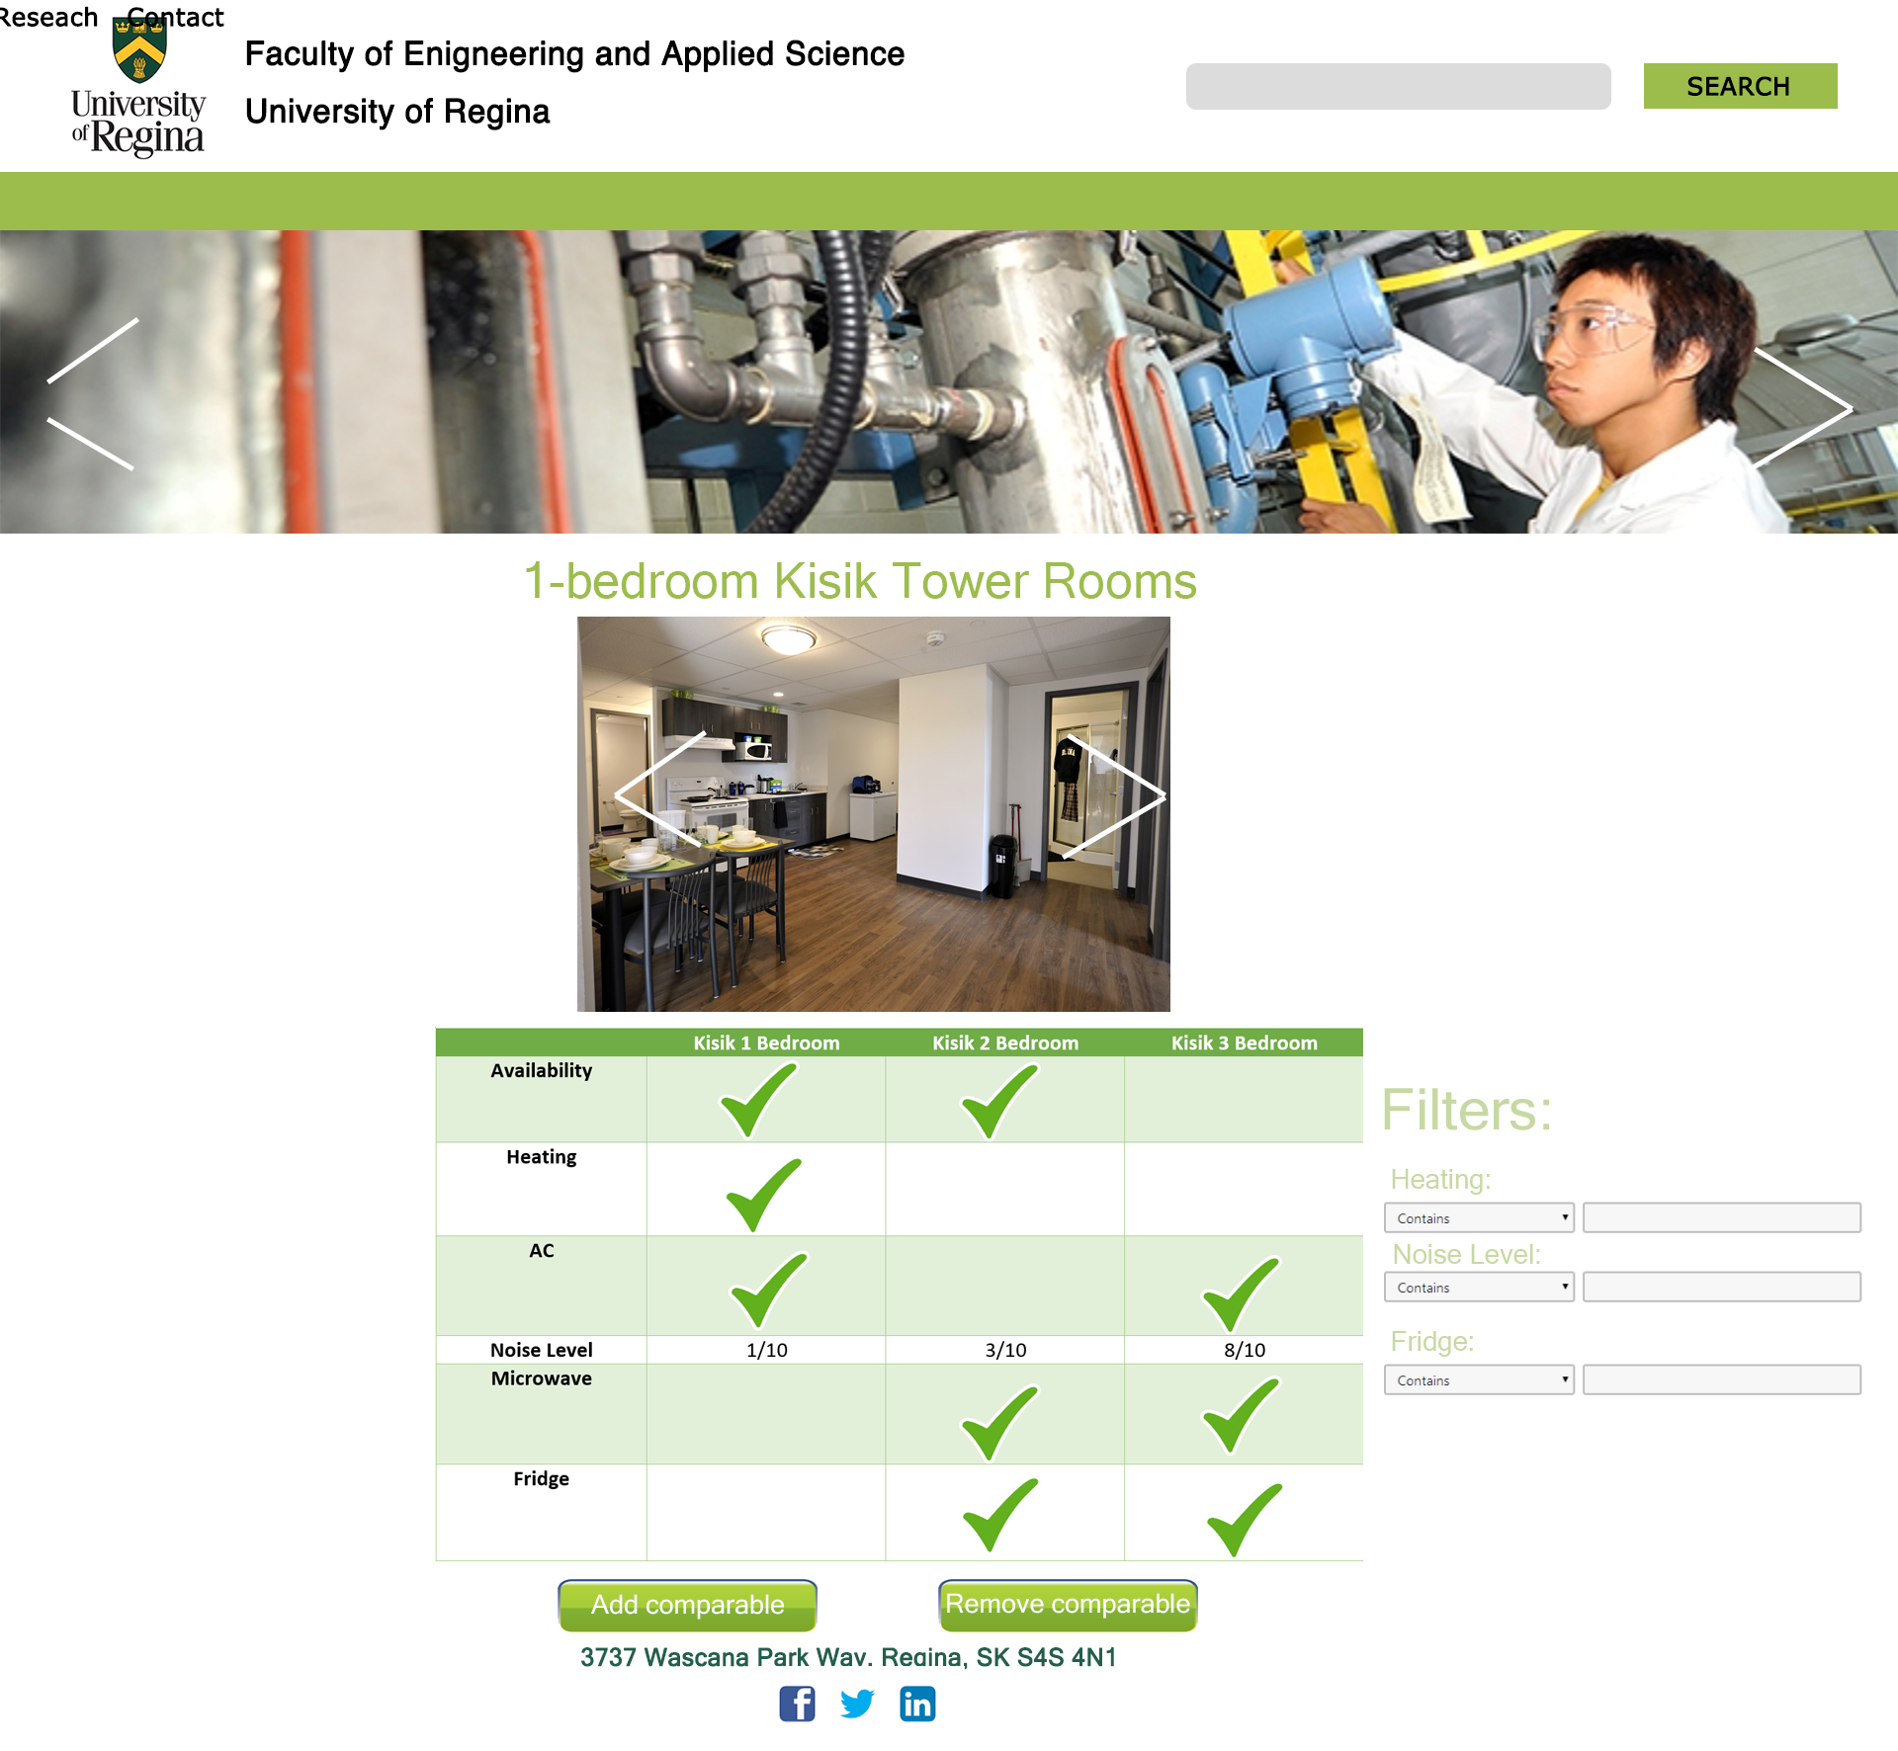
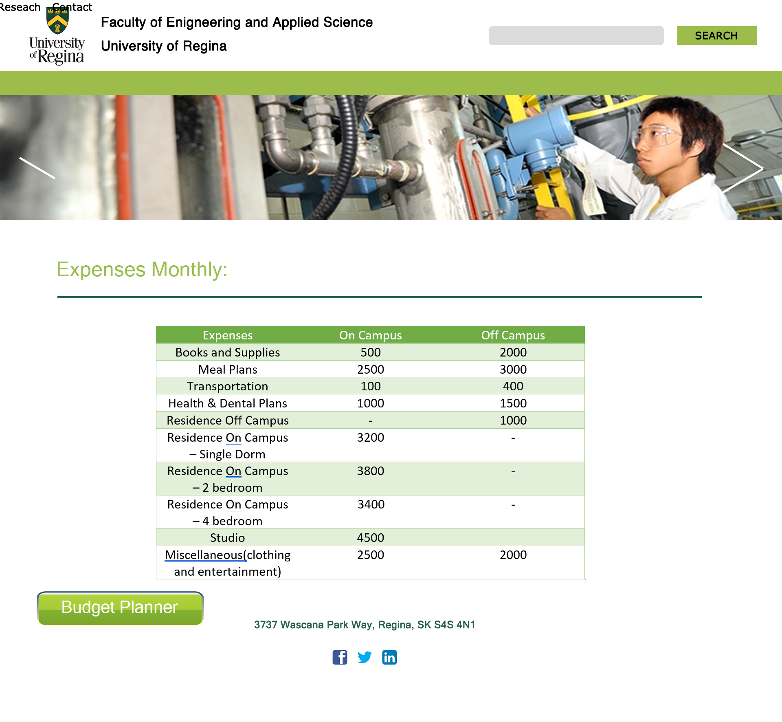
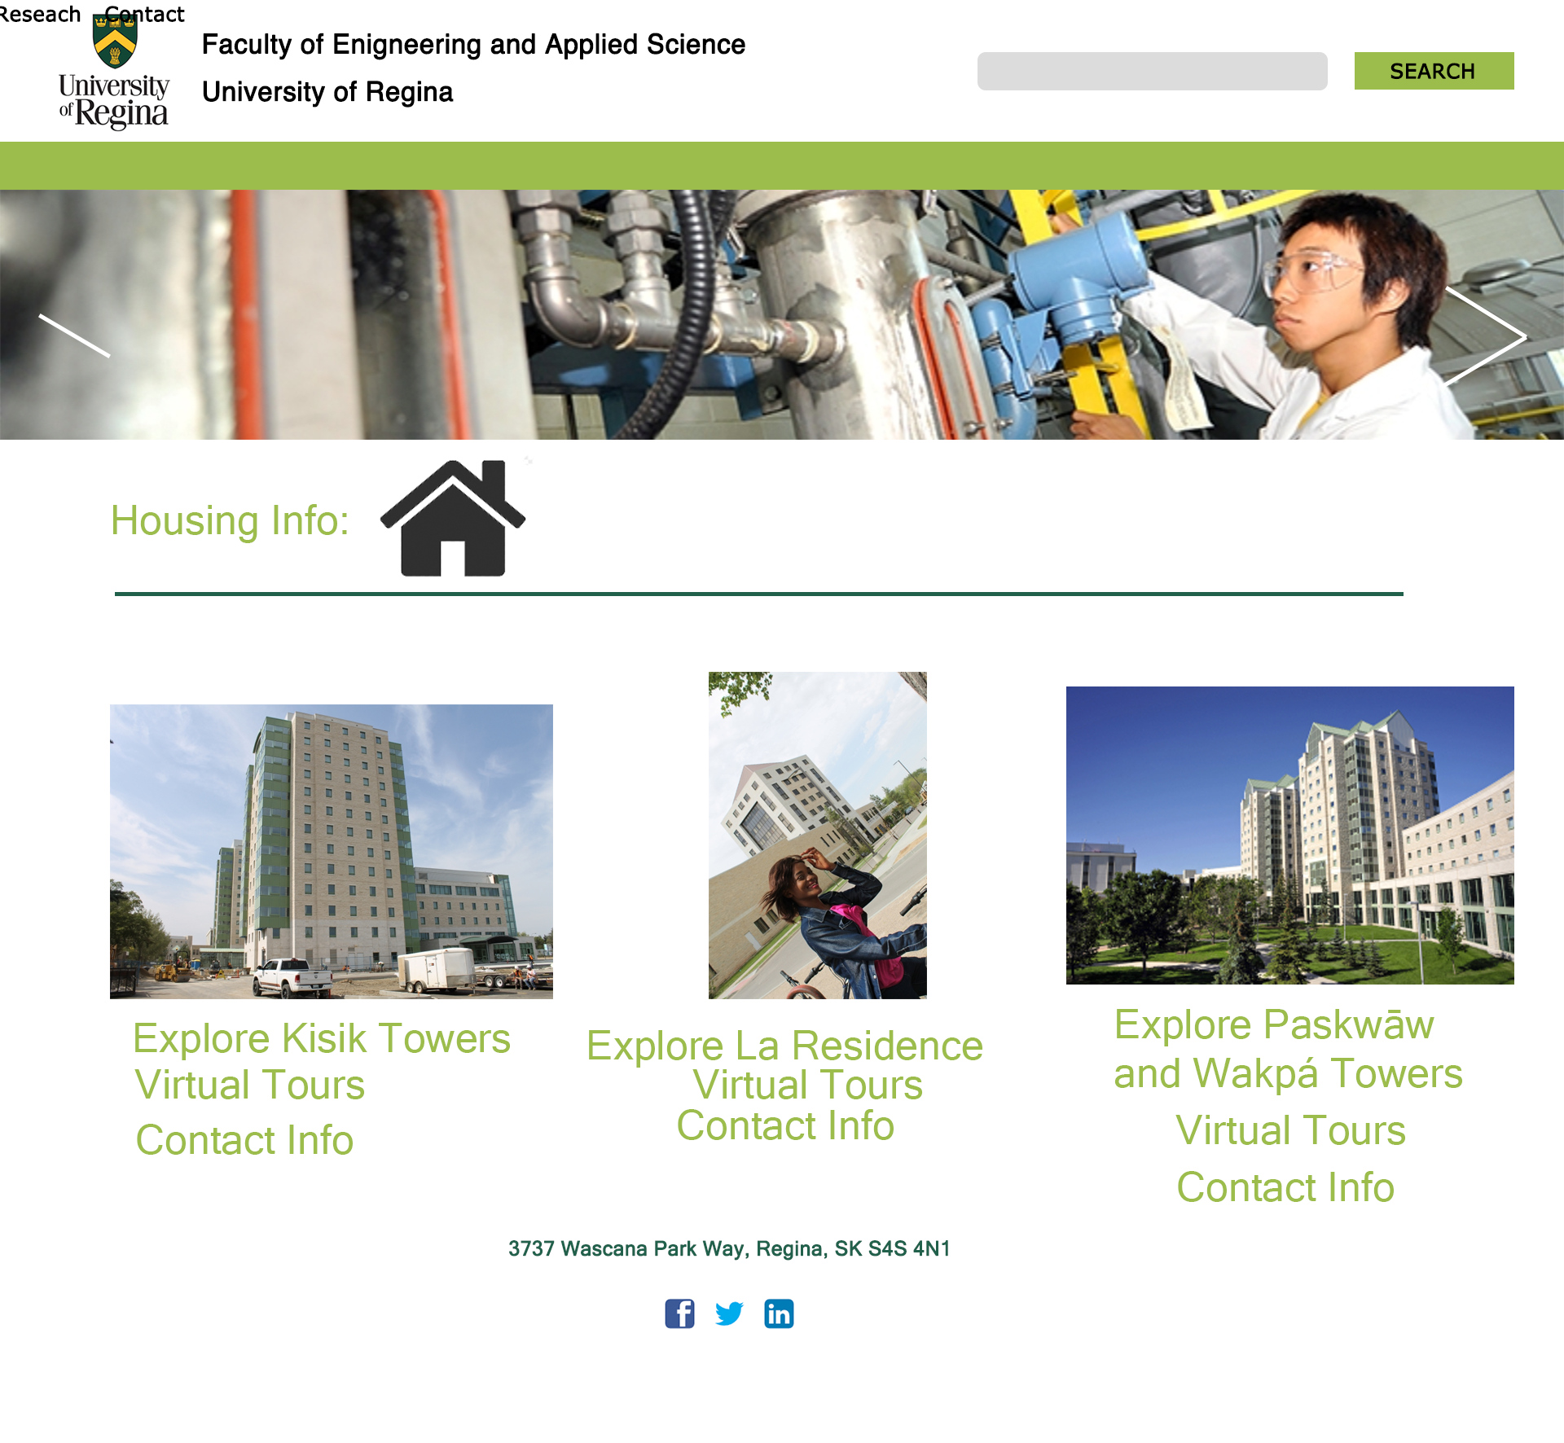
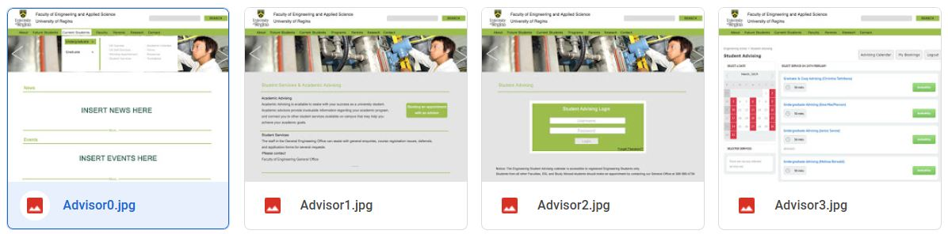
Different ideations...
Notes:
Clark
1. our overall design was to used images to replace overwhelming amount of words.
2. We made it easier to visualize the page flow using Photoshop mockup.

Slide 6
Brainstorm #1: Discussions
Rationalize the number of ideations your team created
After discussion, ONLY one design has been made.
And we felt like our design ideations had a good coverage.
Why did you select the storyboard/lo-fidelity prototype (or some other) approach for your ideations (was it good, bad, better if…?)
Low fidelity prototypes were used for the ideations because it is easy to change and implement designs by using this prototypes.
Notes:
Jinkai

Slide 7
Evaluate #1
Discuss the user feedback you received ?
The main feedback we received is to avoid information duplication, stakeholder priority, and information maintenance.
Discuss your experience in working with your focus group ?
Pros: We learned what our customer needs and wants in the website.
Cons: Demographic Accuracy
Notes:
Zain

Slide 8
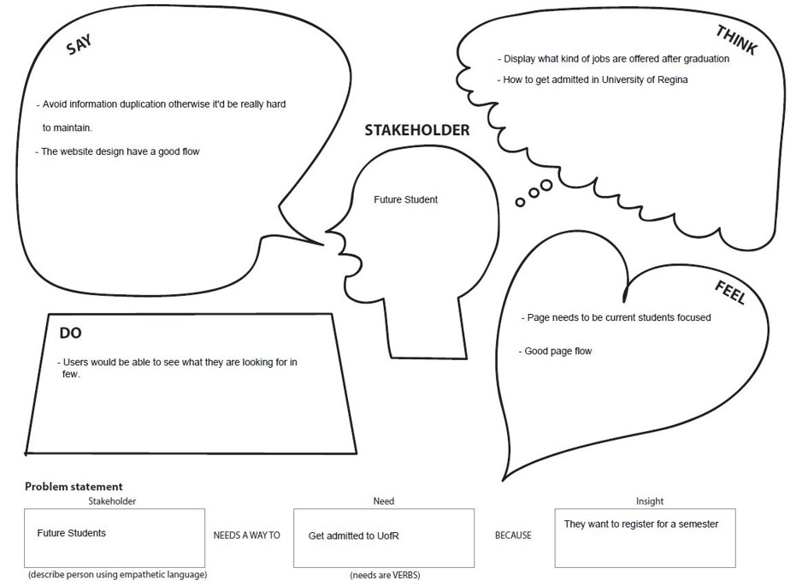
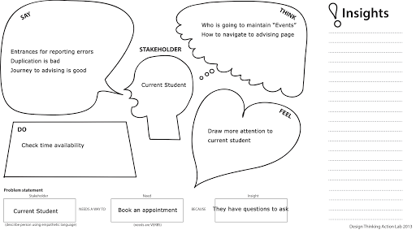
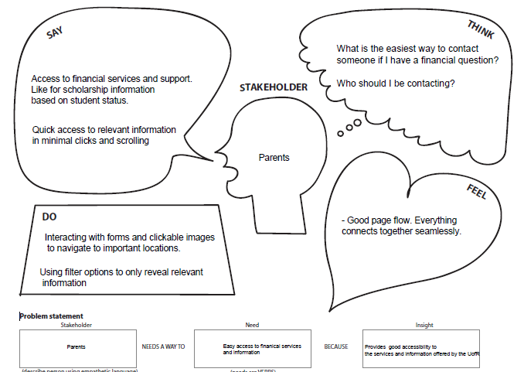
Empathy Maps Discussion
Notes:
Jinkai
Here are the empathy maps for our target customers. We think content duplication must be avoided. Also low maintenance is important. Access informations in few clicks would be better.

Slide 9
Brainstorm #2
Display and discuss your “honed-in/focused” ideation
We’re going to keep our design because according to our survey many current students would like to know what’s going on in the campus.
Display your team’s USM and do a brief first MVP review and rationale
Link back to usability questions as much as possible
Notes:
Zain

Slide 10
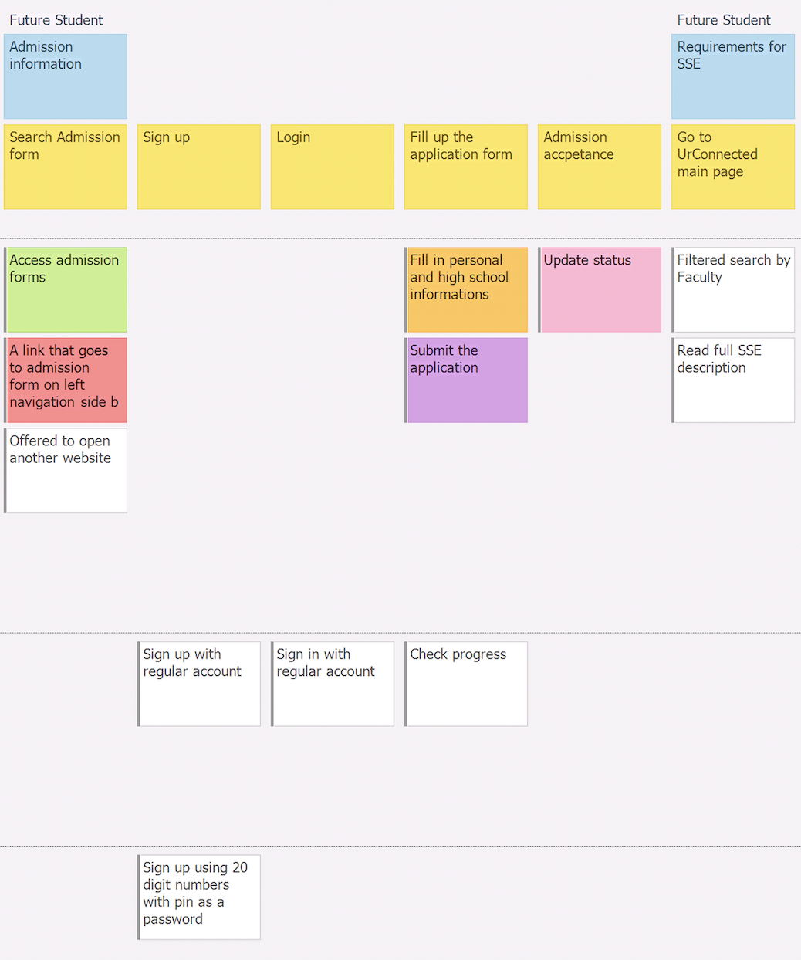
Future Students Usability Questions
How to access admission form? How to filter the navigation to find the form quickly? How to access admission form catered for undergraduate students? What are the ways to determine if form is filled in correctly? How to determine if user got accepted to University of Regina?
Notes:
Clark
Here’s the first MVP for future students that wants to get admitted to university of regina

Slide 11
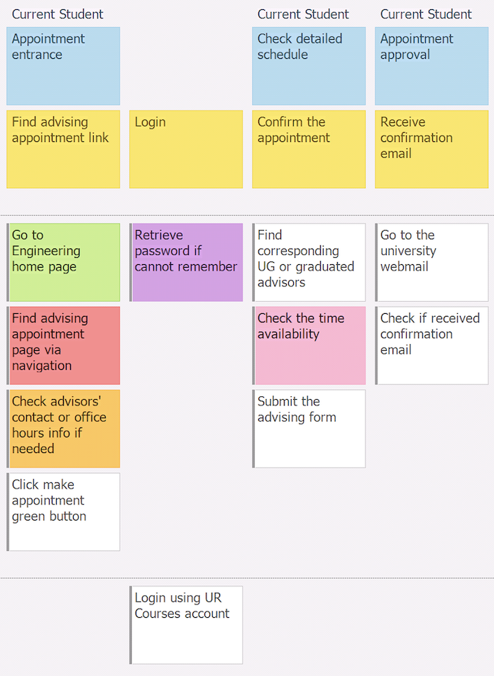
Current Students Usability Questions
How do I find the advising page? Where is the entrance for advising system? How to find advisors contact info? How do I retrieve my UR course password? When is the time availability for each advisor?
Notes:
Clark
Make appointment with engineering advisor

Slide 12
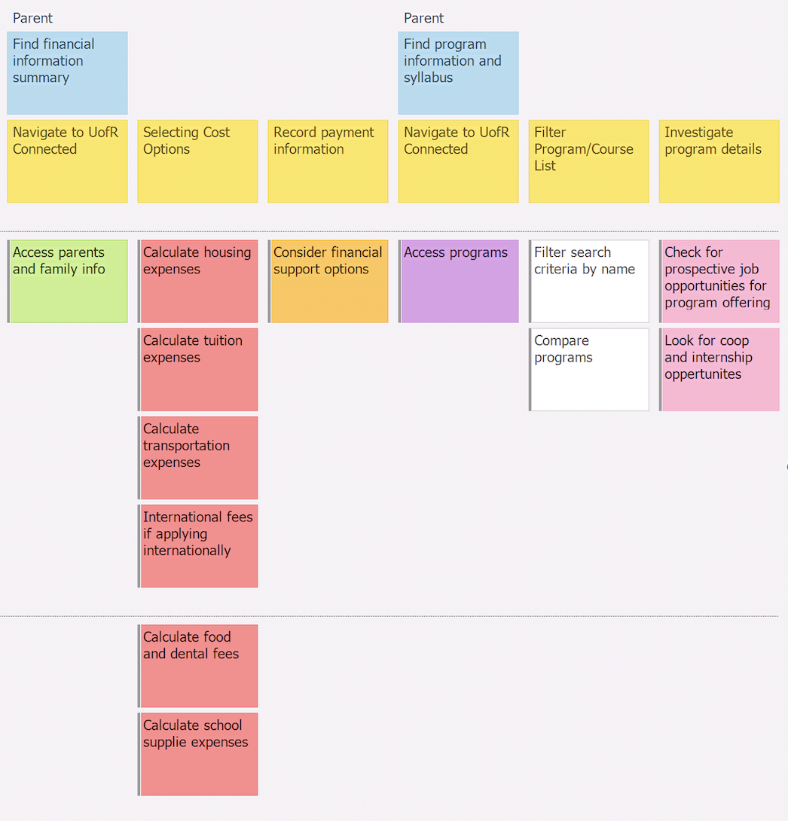
Parents Usability Questions
Where to find information about financial services and support? What kind of information to I need to provide to calculate approximate expenses? Where to find information about scholarships? Where to find program informations? What are the career opportunities for the program selected? Are coop or internship options available?
Notes:
Clark
Finding financial support
To look for program descriptions

Slide 13
GitHub review
Github Link: https://github.com/Yomi471/Milestone2
Discuss its structure and flow
Ensure to illustrate that all Milestone 2 files are uploaded (providing your “stamp of approval”), e.g.
All ideations from Brainstorming #1
Evaluation documentation (Feedback report/summary, empathy maps)
Focused ideation from Brainstorming #2
USM snapshot, etc.
Recall” Your team’s “stamp of approval” includes you are satisfied with your uploaded content and GitHub structure usability/readability (discoverability and understandability)
Notes:
Jinkai

Slide 14
Group reflection
How did you feel about this milestone? What did you like about it?
Milestone was good. For us, it was nice to have feedback from our target customers.
What did you learn about yourself as you collaborated and worked through this milestone?
Brainstorm was effective and useful. Our group worked concurrently to accomplish milestone 2.
How will you use what you have learned going forward?
Visualize the designs was rational intuition and pretty useful for presentation.
What “stuff & things” related to this milestone would you want help with?
Everything’s clear, no need for further help.
Notes:
Jinkai

